Slide 1
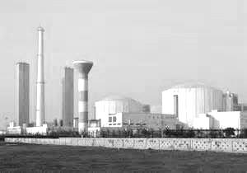
The Stakes in The India Nuclear Energy Market Assessment and Outlook
International Atomic Energy Consulting
IAEC
Vijay K. Sazawal, Ph.D.
June 6, 2017
Special Summit III on Global Nuclear Energy Markets

Slide 2
The Big Picture: Global Nuclear Power Production 2035
International Atomic Energy Consulting
IAEC

Slide 3
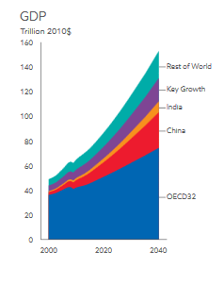
The Big Picture: India’s ranking in top global economies
Current Ranking of Top Global Economies
USA
China
Japan
Germany
U.K.
France
India
Ranking of Top Global Economies in 2020
China
USA
India
(Source: IMF Report, 2016)
(Source: Exxon-Mobil 2016 Energy Outlook)
International Atomic Energy Consulting
IAEC

Slide 4
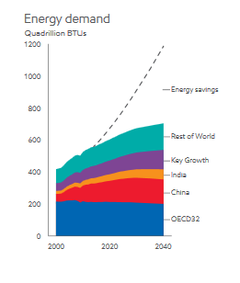
The Big Picture: Energy Demand in India
India is the 3rd largest consumer of energy in the world
India is the 3rd largest producer of electricity in the world. Non-fossil fuels amount to 33% of the energy mix and this number is growing
India’s population will exceed China’s in the next decade
India ratified the COP-21 Global Climate Agreement on April 22, 2016, and committed to reducing carbon dioxide emissions intensity by 33% to 35% by 2030 as compared to 2005 levels
(Source: Exxon-Mobil 2016 Energy Outlook)
International Atomic Energy Consulting
IAEC

Slide 5
Today’S Presenters
Dr. Corey McDaniel
Director, International Programs, INL
Mr. Benjamin Schwartz
Director for Defense and Aerospace, USIBC
Dr. Ravi Grover
Chair, Homi Bhabha National Institute (HBNI)
International Atomic Energy Consulting
IAEC

